Slide 1
Business analysis for Travel Assured
Yuyin Lang
2022.11.25

Slide 2
Outline
Introduction
Project overview
Business goal
Analysis
Travel habits of customers and non-customers
Typical profile of customers and non-customers
Conclusion
Recommendations

Slide 3
Introduction
Project overview
Find travel habits of customers and non-customers
Find typical profile of customers and non-customers
Business goal
Recognize who is more likely to buy travel insurance and deliver them ads

Slide 4
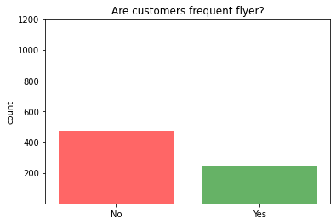
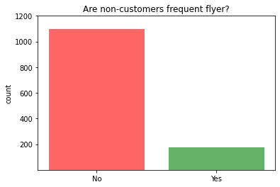
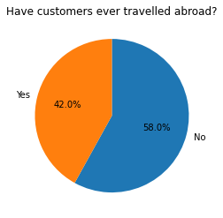
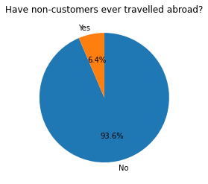
Analysis (Travel habits)
People who fly frequently are more likely to buy insurance.
People ever travelled abroad are more likely to buy insurance.

Slide 5
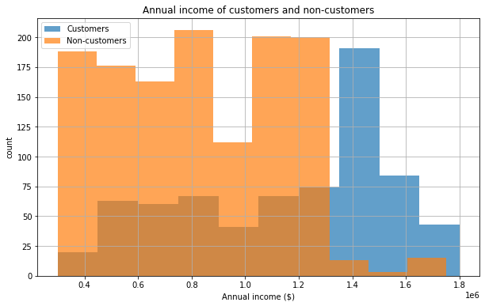
Analysis (Typical profile)
Non-customers
Customers
Average income: $0.82 * 10^6
Median income: $0.80 * 10^6
Average income: $1.13 * 10^6
Median income: $1.25 * 10^6
The annual income of customers is much higher than non-customers
Not much difference are observed for other profile, such as age, employment type, number of family members and so on.

Slide 6
Conclusion
Travel habits
Customers tend to fly frequently, non-customers are less likely to fly frequently
Over 40% of the customers have been abroad, whereas quite few non-customers have been abroad
Typical profile
The annual income of customers is much higher than non-customers

Slide 7
Recommendations
Places to deliver the advertisements: Airports
For both domestic and international flights
Especially VIP lounges (Our customers are rich)
People to deliver the advertisements: High income group
May need more data to analyze where they usually go

Slide 8
Questions?

